Slide 1
Myths and reality of the BLOCKCHAIN TECHNOLOGY in the auditing and consultancy profession
Laura Sierra-García
Carmen Correa Ruiz
Esther Albelda Pérez
Michaela Bednárová
University of Pablo de Olavide
ACCOUNTING AND AUDITING IN AN ARTIFICIAL INTELLIGENCE ENVIRONMENT. SEVILLA

Slide 2
CONTENT
INTRODUCTION
LITERATURE REVIEW
METHOD
RESULTS
CONCLUSION

Slide 3
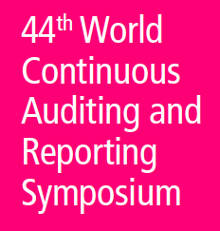
INTRODUCTION
Today businesses are more complex and internationally connected.
New regulations, accounting and auditing standards (Europe – “Key Audit Matters“, 2016; USA “Critical Audit Matters“, 2020), adding complexity, and increasing the cost of control and reporting for businesses.
- a need for efficient solutions
Blockchain Technology (BT), a distributed digital ledger, could help business by making digital transactions more efficient and safe.
BT has been indicated as game-changing disruptive innovation that has the potential to transform industries and the structure of markets (Deloitte, 2016)
Notes:
New regulations – increase cost of control and reporting – we have to look for efficient solutions
Blockchains feature: decentralization, immutability, cryptology

Slide 4
INTRODUCTION
OBJECTIVES
This research aims to explore the role of Blockchain Technology (BT) in auditing from the perspective of auditors and consultants to identify the real opportunities and challenges emerging from its implementation.
Notes:
Despite all the hype, there are some contradictory opinions.
We wanted to know how fare we are... How high is the awareness of this technology among auditors.... Most importantly, do auditors know what is happening (☺)... What are their perceptions and expectations

Slide 5
LITERATURE REVIEW
Accounting and Auditing Academia.
Professional Firms.
Professional Bodies.
Notes:
WE ARE GOING TO DIVIDED THE LITERATURE REVIEW FROM 3 DIFFERENT POINTS OF VIEW:
ACADEMIA
PROFESSIONAL FIRMS
PROFESIONAL BODIES

Slide 6
LITERATURE REVIEW
Accounting and Auditing Academia.
Increase transparency and auditability
Reduce auditing cost, human errors, and fraud.
Ensure data integrity and enable automated auditing (Rozario and Vasarhelyi, 2018).
Facilitate real-time supervision to reduce auditing risk.
Continuous Accounting and Auditing (Dai and Vasarhelyi, 2017)
Auditors more IT than accounting oriented and become more forward than backward-looking. The profile of the auditors will change.
More sceptical point of view (Coyne and McMickle, 2017)
Notes:
WE HAVE FOUND PLENTY OF THEORETICAL STUDIES RELATED TO BLOCKCHAIN, BITCOIN, FINTEC BUT WE HAVE FOUND FEW STUDIES RELATED TO ACCOUNTING AND AUDITING CONTEXT.

Slide 7
LITERATURE REVIEW
Professional Firms: Audit firms Initiatives.
EY: Building tools to help companies identify risks in the Blockchain. Libra, which is a distributed ledger focused start-up.
Deloitte: Focusing on the technical development and implementation of Blockchain technology. Rubix software platform where customers of the company can design their own smart contracts and other applications.
KPMG: Auditing, taxing and analyzing Blockchain integration. KPMG's Digital Ledger Services in collaboration with Microsoft.
PWC: Investment in VeChain, is building supply chain of the future. 1,000 staff in the Blockchain.
Notes:
Big-4 have led the research on Blockchain Technology.
DELOITTE has published different documents since 2016
This survey was commissioned by Deloitte Consulting LLP and conducted online between March 26 and April 5, 2018. The survey polled a sample of 1,053 senior executives in seven countries (Canada, China, France, Germany, Mexico, United Kingdom, and the United States) at companies with $500 million or more in annual revenue. Respondents had at least a broad understanding of blockchain and were familiar with and able to comment on their organizations’ blockchain investment plans.

Slide 8
LITERATURE REVIEW
Professional Firms: Audit firms Documents.
EY (2017); Deloitte (2016); KPMG (2018); PWC (2018):
The way businesses are audited will clearly change.
Standardization would allow auditors to verify a large portion of the most important data behind the financial statements automatically.
Greater focus on more complex transactions and internal controls, fundamentally changing the scope and approach of an audit opinion.
Role of auditor would change, who would focus on confirming in conjunction with accounting standards rather than auditing transactions.

Slide 9
LITERATURE REVIEW
Professional Firms: Audit firms Documents.
Audit teams expertise and technologies required
Auditors would involve in reviewing the technology’s implementation, assessing the quality of incoming and outgoing data, and identifying cybersecurity-related risks.
Change of collecting audit evidence.
Audit operating costs would be reduced.
New audit strategy: continuous and real-time auditing.

Slide 10
LITERATURE REVIEW
Professional Firms: Certifier firms Initiatives.
SGS: Komgo will launch a new Blockchain-based platform before the end of the year that will transform commodity trade finance by enhancing efficiency and strengthening security.
BUREAU VERITAS: Origin is based on an easy Blockchain system, which is open, transparent, secured, and operates without central controlling device. With the Blockchain technology, the full lifecycle of the product can be digitally replicated and shared among the different players.

Slide 11
LITERATURE REVIEW
Professional Bodies.
American Institute of Certified Public Accountants (AICPA). impact all recordkeeping processes, including the way transactions are initiated, processed, authorized, recorded and reported. Changes in business models and business processes may impact back-office activities such as financial reporting and tax preparation.
Institute of Chartered Accountants in England and Wales (ICAEW): more efficiently and have lower operating costs. But the rewards are trustworthy records and reduced reconciliations. Accountants’ skills will need to expand. Auditors and regulators with access would be able to check transactions in real time.

Slide 12
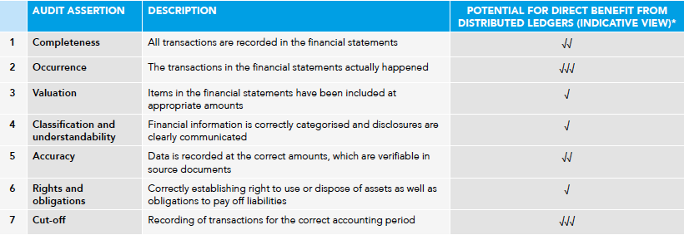
LITERATURE REVIEW
Professional Bodies.
Association of Chartered Certified Accountants (ACCA)
Blockchain help audit: Immutability, sampling, timing, and true and fair view

Slide 13
METHODS
PILOT STUDY
Phase 1: Semi-structured interviews (Auditors).
Phase 2: Semi-structured interviews (Certifiers).
Phase 3: Focus group: Auditors/Certifiers/Companies.

Slide 14
METHODS
Identifying three building blocks
Opportunities and Challenges
Role of BC
Implementation and Impact

Slide 15
METHODS
The role of Blockchain Technology and extent of knowledge.
1. Are there currently initiatives related to Blockchain technology (projects / training / working groups) in your organization?
2. How would you describe the role of Blockchain technology in the current context?
3. How would you evaluate your level of knowledge of Blockchain technology?

Slide 16
METHODS
Opportunities and challenges of Blockchain Technology for audit function.
4. What opportunities do you think BT can offer to companies in general? And in relation to the audit processes?
5. What challenges does BT entail in general? And in relation to the audit processes?
6. How can BT affect the collection of evidence, the audit tests and the work methodology employed by the auditors?
7. To what extent are audit professionals prepared for the adaptation suggested by BT? How should the auditor's training curriculum be changed to meet the challenges of this technology?

Slide 17
METHODS
Implementation of the Blockchain Technology and impact on the markets.
8. How do you think the regulators of financial markets will respond to BT?
9. Although many of the benefits of this technology have been revealed, limitations and ethical issues that must be considered have also been pointed out. What can you say about it?
10. When do you think BT will be implemented effectively and Blockchain-based continuous audit would be fully performed in organizations?

Slide 18
METHODS
Research Design
Identify the objectives
Identify participants
Data Collection
Pre-session preparation
Facilitation during meeting
Analysis
Discourse analysis
Conversation analysis
Results and Reporting
Indentify location

Slide 19
RESULTS
The role of Blockchain Technology and extent of knowledge.
Regarding the current BT initiatives, there are some initiatives, but mainly in advisory department so a common auditor is not in touch with them.
BT is generally perceived as a hot topic, but some auditors also connect it with a database for speculative investment. Others consider BC too complex for general use with very low benefits publicly presented.
The level of knowledge is generally very low and so far they even seem to be reluctant to engage with this technology in their daily routine as auditors. At this moment, they kind of can´t imagine how it will be designed to work properly.

Slide 20
RESULTS
Opportunities and challenges of Blockchain Technology for audit function.
Opportunities: cybersecurity, improved information quality and legitimacy of transaction, decrease the fraud risk, improve the control processes.
Challenges: not every company might be willing to adopt this technology, the need of involvement of IT auditors and developers, hard to collect the documentation.
Collection of evidence: easy access, much safer and faster, higher efficiency, lower risks of human errors.
Auditor's training curriculum: not focusing on blockchain, will be huge initiatives and trainings, on the general understanding of this technology.

Slide 21
RESULTS
Implementation of the Blockchain Technology and impact on the markets.
Regulators of financial markets: transformed to “IT Audit”, no soon due to complexity of understanding, harder for state regulators.
Limitations and ethical issues: ethical issues will be revealed late.
Implementation and continuous auditing not believe in a close future, need a significant reengineering of AISs and related methodology, significant cost for auditing.

Slide 22
CONCLUSION
The effect of Blockchain Technology on the profession is not fully anticipated and smaller auditing firms
Skills of Auditors will change (more IT oriented and more forward-looking). Are they prepared?
Collection of evidence will be faster, safer, more efficient, with lower risks of human errors.
Harder for state regulators. Are regulators adapted?
Implementation and continuous auditing not expected in a close future.
Notes:
REVISION DE LA LITERATURA
VENTAJAS E INCONVENIENTES
BV TRAZABILIDAD: CLIENTES
SMART CONTRACTS
CONTINOUS AUDITING

Slide 23
CONCLUSION
Internal challenges
Technological aspects (appropriate BC design and architecture, smart contracts solutions, etc.)
New skill set of auditors needed (IT skills)
Smooth transition
Training:
Demand (new skills are needed – IT skill set)
Mind set (understanding of technology and its benefits)
Technology acceptance – corporate culture will play an important role
To facilitate a smooth transition might be the most challenging task. Training will play an important role.

Slide 24
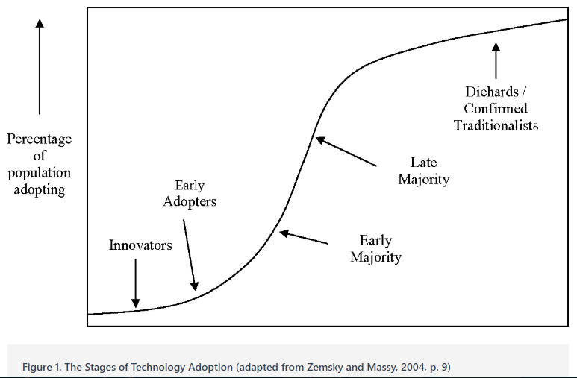
CONCLUSION
External challenges
Stages of technology adoption
We might enter into a limbo where technology would advance faster than regulators` consensus
Notes:
Dai and Vasarhelyi (2017) introduce three different contexts of challenges (technological, organizational and environmental)
Technological: reers to the technical complexity which requires financial and time resources (company might struggle to find business partners to share the ledger with)
Organizational context: refers to willingness of managers to accept this innovative approach (benefits must exceed the potential costs)
Environmental context: points out the essential role of regulators in adoption of BT within the accounting ecosystem

